Slide 1
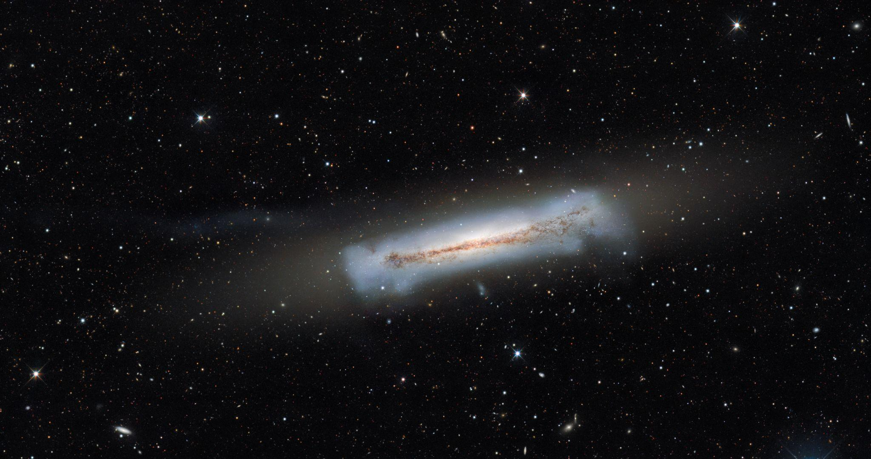


The Role of Compact Galaxies in Reionization
By: River Schmidt-Eder (Carleton College)
Mentor: Anthony Pahl (Carnegie Observatories)
Notes:
Hi everyone my name is River Schmidt-Eder and in collaboration with Tony we have been attempting to constrain the sizes of high redshift galaxies in order to understand their role in the reionization process.

Slide 2
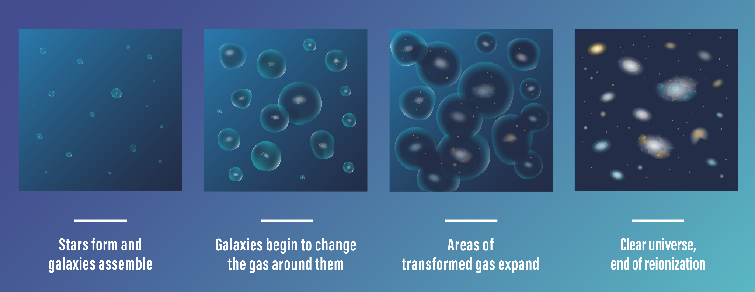
What was Reionization and What Is It?
(NASA, ESA, CSA, Joyce Kang (STScI))
Notes:
Alright so first things first, reionization, what is it, and what does it mean? Well, reionization is essentially when ionizing light ionizes neutral hydrogen in the Intergalactic Medium, and it matters because reionization is a phenomenon that’s responsible for how our universe looks today.
You see, in the first 100 millions years of the universe ionizing light couldn’t travel far, always coming into contact with close up hydrogen making the universe opaque to it.
A billion years later though as ionization began to take its toll, the universe started to take the shape that it has today with less hydrogen gas between each galaxy and galaxies in general in more distinct groups.
In essence, this is why we’re interested in studying reionization because we want to get a better idea as to how this happened and how the universe formed.

Slide 3
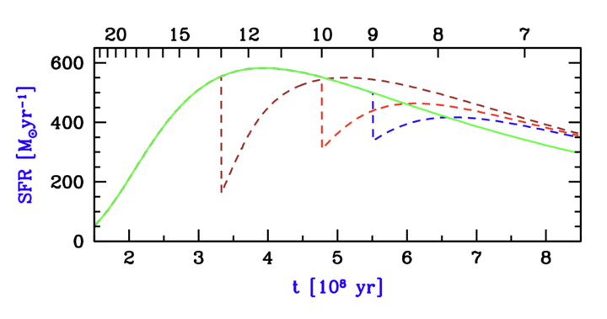
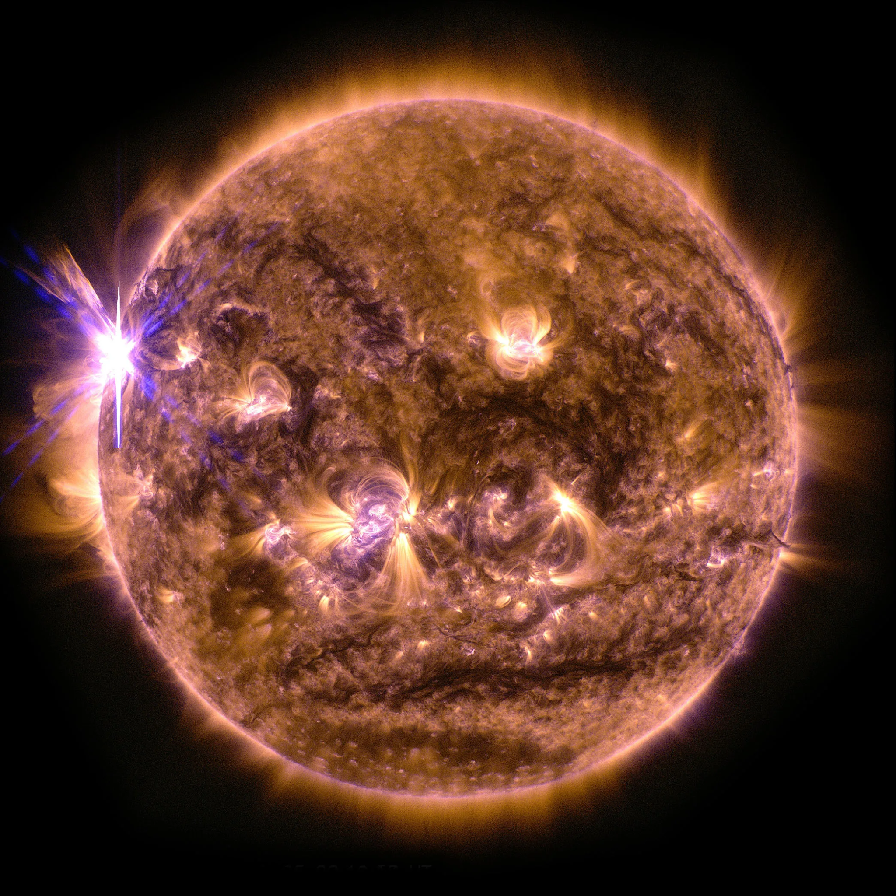
How does Reionization Impact Galaxy Evolution?
More Area
Less Area
z = 10
z = 13
z = 9
No Reionization
(NASA/Goddard Space Flight Center/Solar Dynamics Observatory)
(Adapted From Barkana & Loeb 2018)
Notes:
You might be wondering though, what else does reionization affect?
Well, in addition to the transparency of the universe to ionizing light, reionization also affects star formation rates.
This is because after it becomes ionized hydrogen can no longer turn into fuel for stars.
This basically means that more ionization means less star formation.
The graph on my left from Barkana & Loeb shows this pretty well. These different lines all show how star formation would have happened had reionization occured at different times.
On the Y-axis we have star formation rate and its as a function of hundreds of millions of years.
The different colored lines assume different times of reionization. The green line assumes no reionization, and the brown, red, and blue line show what would happen if reionization occurred at redshift 9, 10, or 13, respectively.
What you’ll notice is that there’s a lot more area under the curve for that green line that assumes no reionization than there is for that blue line that assumes it happens at z = 13 or at the start of the universe.
And this dramatic difference shows pretty well just how big of a difference reionization makes toward how stars formed in our universe.

Slide 4

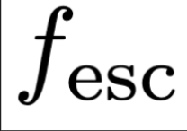

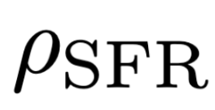


How We Quantify a Galaxy’s Ability to Drive Reionization:
Ionizing Emissivity
The Three Parameters:
=
x
x
Ionizing Photon Production Efficiency
(Goal of this study)
Star Formation Rate
Fraction of
Escaping Photons
(Robertson + 2015)
Notes:
Okay, so we understand that reionization has a pretty significant impact on how the universe forms, but how can we quantify that? Well, it all starts with parameterizing the evolution of reionization as a function of three variables.
Ionizing emissivity describes the amount of ionizing photons entering the intergalactic medium. Its equation is Nion equals (f escape) times (psi ion) times (row SFR). We use this equation to determine how many ionizing photons are being produced and escaped from a given galaxy.
For our research we are specifically focusing on (psi ion) or how the ionizing production efficiencies work in different galaxies in their production of ionizing photons.
That being said, the fraction of photons escaping a galaxy, which I’ll discuss a bit in the slide after next, and the star formation rate of that galaxy, also play a role in how many ionizing photons that galaxy produces.

Slide 5
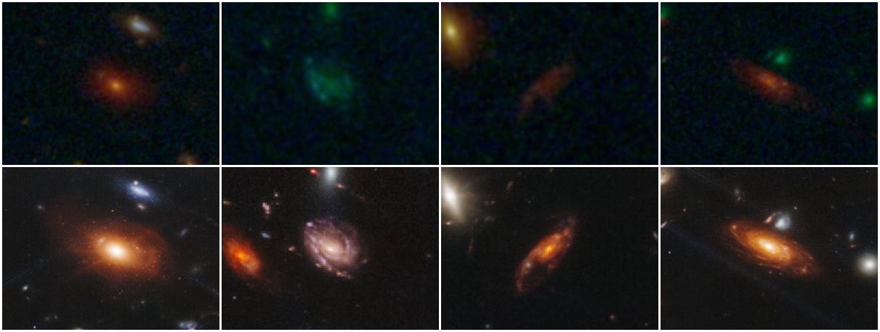
Why Study Reionization Now?
Hubble
JWST
(NASA/ESA/STScI)
Notes:
Okay, well it’s cool and all that we can parameterize this stuff, but why study reionization now? Well, with the launch of JWST we now have the new ability to study the distant universe with new and improved technology. With this new technology we can now study galaxies that were far beyond the reach of Hubble. This is because JWST includes spatial resolution that exceeds that of Hubble. In addition it also has better near infrared capabilities making it more sensitive to redshifted light. This recent advancement is why we’re studying reionization now as opposed to having started earlier.

Slide 6
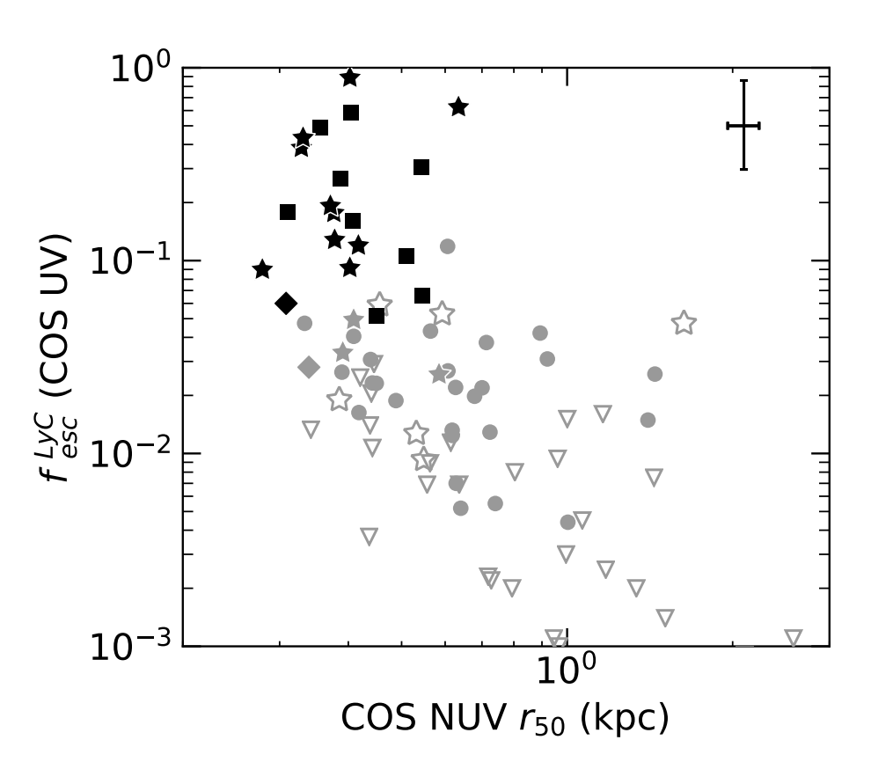
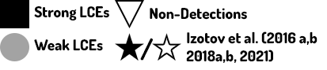
Why Care about Galaxy Size?
Lyman Continuum Escape Fraction
Galaxy Size (kpcs)
(Flury + 2022)
Notes:
But where did we even get the idea to begin with that ionizing photon production efficiency could somehow be tied to the compactness of these galaxies?
Well what you’re looking at now is one of the motivating figures for our research project. It’s a graph from Flury et al. which shows a correlation between two units. The y-axis showing the fraction of escaping Lyman continuum photons compared to the galaxy size in kiloparsecs on the X-axis.
Different shapes in the data points denote data taken at separate observation times and more filled in data illustrates galaxies with more significant escape fractions. Anyways as you look you’ll notice an anticorrelation between the radii of these galaxies and the escape of this ionizing light which is what has motivated us to dive into this project and investigate this phenomenon further. We’re motivated to understand if these compact galaxies also have high ionizing photon production efficiencies in addition to their high escape fractions. This is because if they do it’s likely that they play a very large role in reionization.

Slide 7
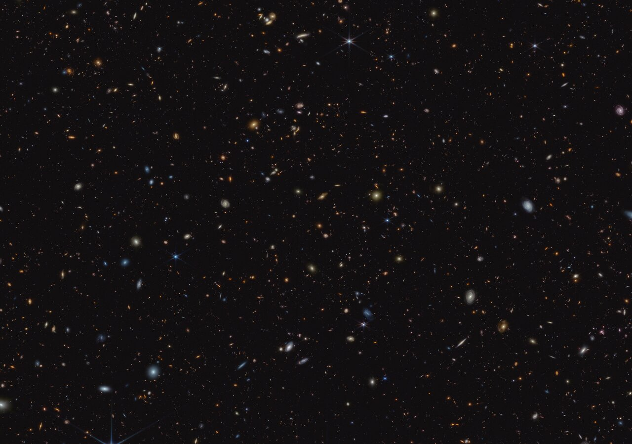
JWST’s Advanced Deep Extragalactic Survey (JADES) (Eisenstein et al. 2023, Program ID: 1210)
Field: GOODS-S
Filter: F115W
Rest Ultraviolet Imaging
40 Galaxies from 2 < z < 6
ξion from JWST/NIRSpec (Ha) and JWST/NIRCam (UV Luminosity) (Pahl + 2024b)
NASA, ESA, CSA, B. Robertson (UC Santa Cruz), B. Johnson (Center for Astrophysics, Harvard & Smithsonian), S. Tacchella (University of Cambridge, M. Rieke (Univ. of Arizona), D. Eisenstein (Center for Astrophysics, Harvard & Smithsonian), A. Pagan (STScI)
Notes:
Okay, so we’ve covered our motivations, and a good amount of our background information, but where will we be getting our data? When we’re interested in measuring this relationship between size and ionizing photon production rate, the best place for us to look is places where there’s new excellent JWST data, JWST’s Advanced Deep Extragalactic Survey (JADES) is an example of a survey in which there was photometric and spectroscopic observations taken so we have images that I will use to measure galaxy sizes which come with spectroscopy data relevant to our ionizing photon production efficiencies that we can use in this study. The ionizing photon production efficiencies were measured in Pahl 2024 b. The photos were taken specifically in the GOODs South field at F115W meaning in a 1.15 micrometer wide filter in the near-infrared spectrum. This filter corresponds to rest ultraviolet imaging for galaxies in our redshift range of 2 to 6.

Slide 8
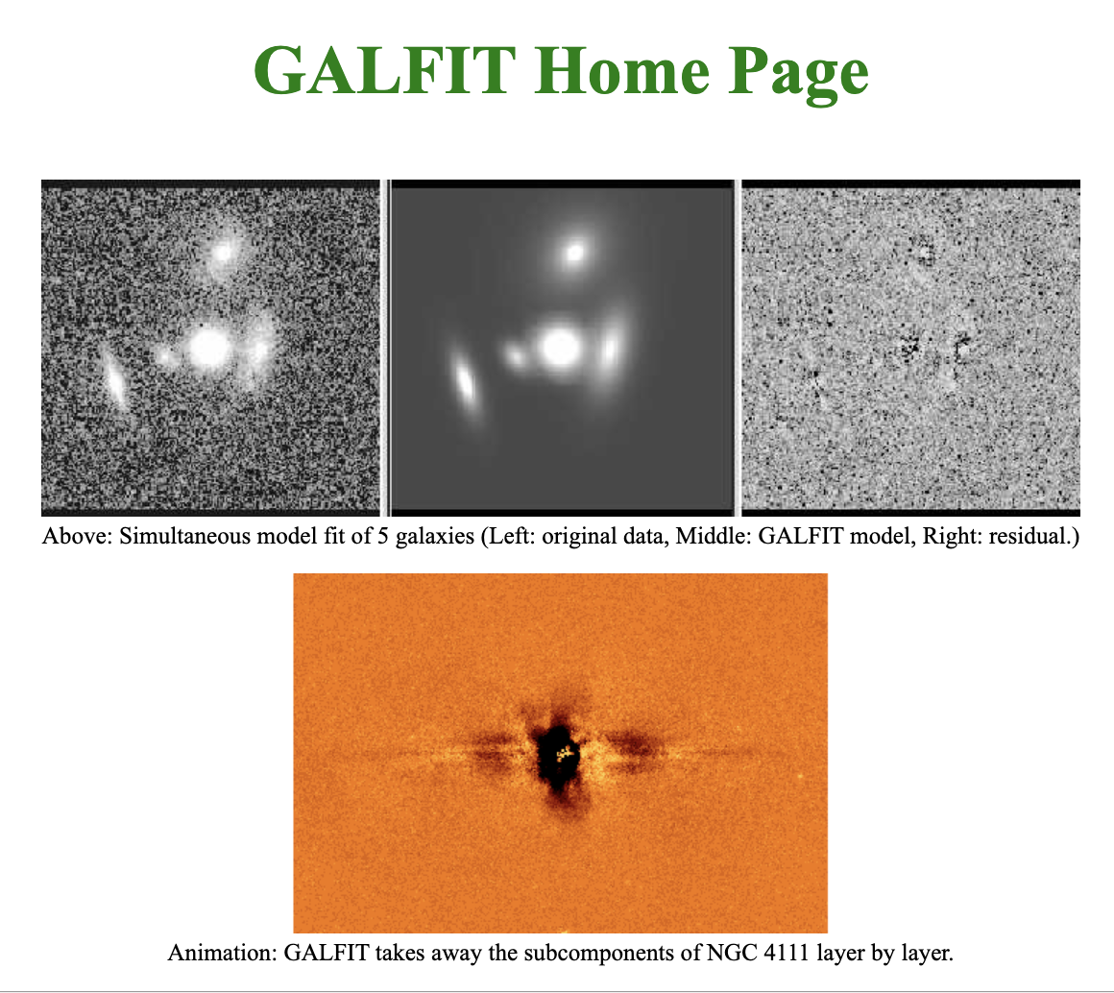
Galfit (Fits Models to Galaxies to Determine Their Size)
Peng (2010)
Notes:
Alright, so now that we have our area to research we now have to have a tool for doing that research and that’s where GALFIT comes in. The way we determine sizes of galaxies is we fit synthetic 2D light profiles to the images. We do this model generation by using a software called GALFIT.
It's what we’ve been spending all our time collecting the prerequisites for, and it’s the tool that actually determines what the sizes of these galaxies are.
Basically what it does is it’ll take a science image, a point spread function, a bad pixel map, and parameters, all of which I’ll explain, and it creates more accurate models of what the shapes of these galaxies really look like so we can determine their sizes.

Slide 9

Generating Point Spread Functions (PSFs) to Describe Light Spread:
(“Point Spread Function” - Wikipedia)
Notes:
When using something like GALFIT it's important to note that the images that we get in our actual telescope don’t exactly describe the true light profile coming from a galaxy. I don’t know how many of you guys know this but basically any time light enters some sort of optics, it’ll get spread out before becoming an image, and what the point spread function will describe is by how much. The PSF is useful because it helps us to account for spread inherent to our imaging so we can get a more accurate representation of a galaxy’s shape in our model. For our specific research we generated a PSF via averaging the light profiles of 15 stars and provided it as an input to Galfit.

Slide 10
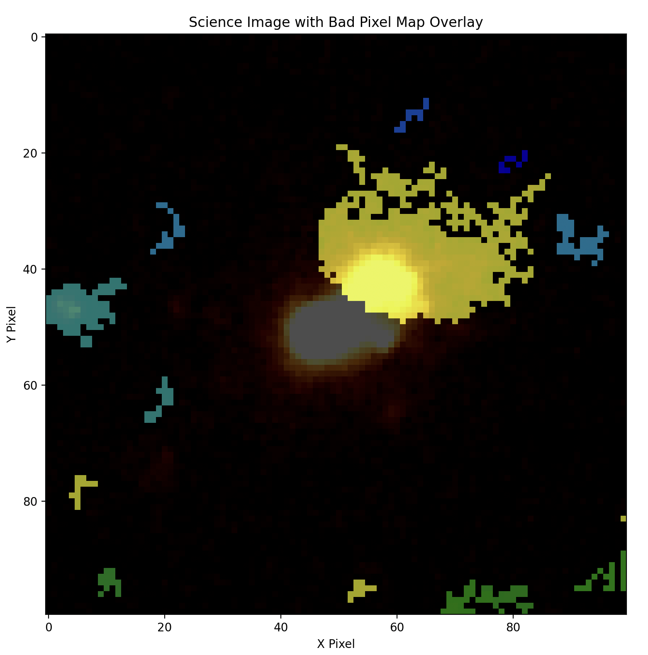
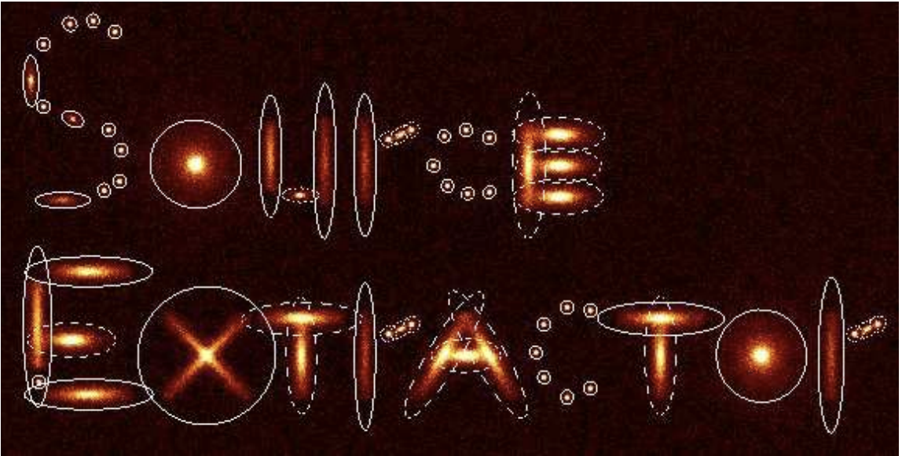
Bad Pixel Maps (Created with Source Extractor):
(Bertin and Arnouts 1996)
Notes:
Nonetheless, not all pictures of galaxies that we want to measure are perfect, and that’s where Source Extractor comes in. Sometimes when attempting to fit a model to a galaxy, we have areas of light that could be falsely interpreted as being a part of a galaxy’s size, and we need tools that can help us to mask those things out to prevent them from providing misinformation to our modeling software. Source Extractor accomplishes this by creating Bad Pixel Maps. Essentially what it does is once we have the cut outs of our galaxies it’ll draw or mask out anything that isn’t meant to be the galaxy that we’re measuring in these little pixeled out colorful areas. Collectively these areas make up what we call a Bad Pixel Map. These maps help to ensure that the light that we’re feeding Galfit is actually from the galaxy from the center of our cutouts instead of some other object near it that could mess up our model.

Slide 11
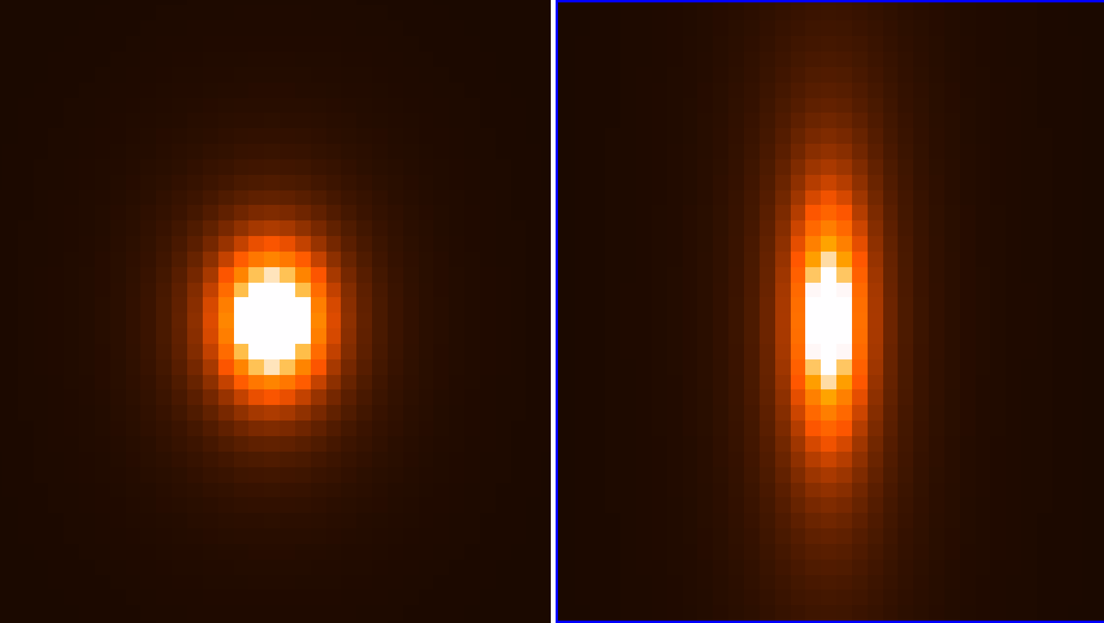
Galaxy Modelling and Sersic Fit Parameters:
Fit Parameters:
X-Center Position
Y-Center Position
Magnitude
Effective Radius
Sersic Index
Axis Ratio
Positional Angle
Effective Radius: 3px
Axis Ratio: 0.75
Effective Radius: 10px
Axis Ratio: 0.3
Notes:
One of the last things that we worry about with GALFIT are its fitting parameters. When fitting galaxies to Galfit there are many parameters that it’ll take an initial input on before it starts its model generation. The two parameters we care most about are a galaxy’s effective radius and its axis ratio as these are the most important toward determining a circularized galaxy size in kiloparsecs. The effective radius describes where half of the galaxy’s light lies from its center which we use to determine the galaxy’s size. And the axis ratio describes the ellipticity of the galaxy. We will essentially combine those two measurements with math in order to get the distance these galaxies occupy in physical distance in order to do our research.

Slide 12
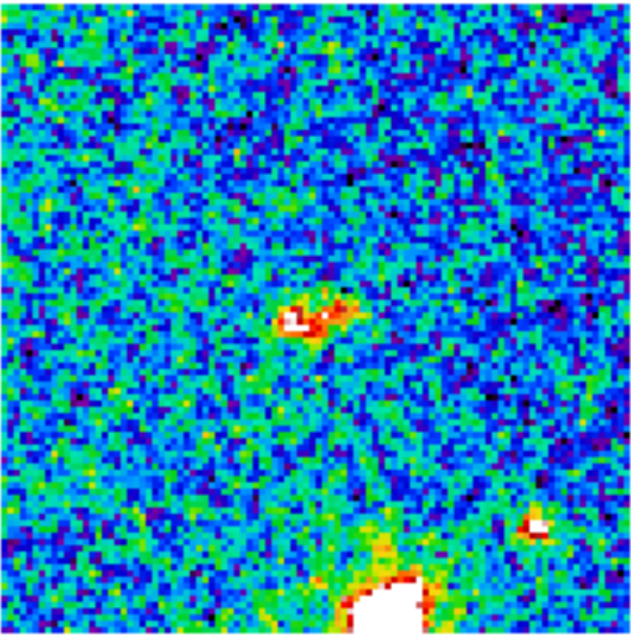
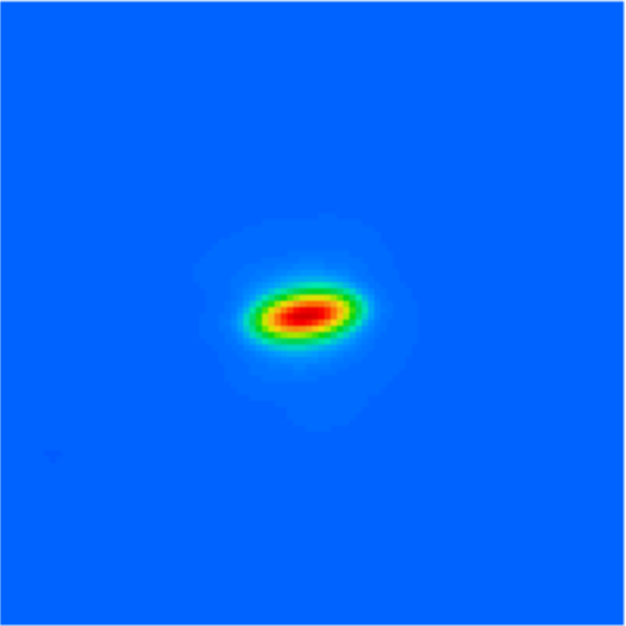
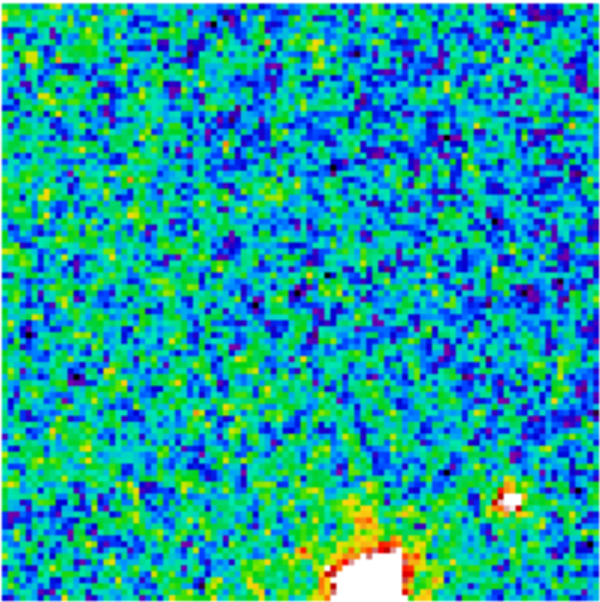
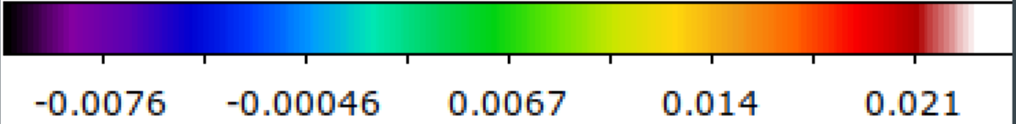
Determining The Quality of Our Fits:
Science Image:
Model:
Residual:
Notes:
Nevertheless, after performing a fit we want to determine whether our Sersic profile or model is accurately describing the light of a galaxy. For that we turn to these three images: the science, model, and residual image. The residual image is one of the more important of the two, because it helps us to understand how well our model fits into the original space of the galaxy in our science image. If the noise levels seem to be about the same as seen in the science image, we’ll know we’ve made a good fit and that we can continue through with our analysis.

Slide 13
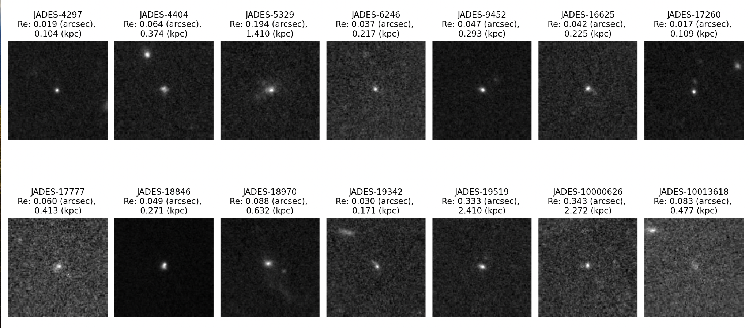
We Measure the Size of 40 Galaxies:
Notes:
So what did we get for some of our results of our galaxies? Well, pictured here are 14 simple morphology galaxies from the early gathering of data about our galaxy sizes. There’s a good variation of sizes even in this first batch of galaxies with sizes ranging from 0.1 to 2.4 kiloparsecs. While most of these galaxies are simple point galaxies, even in these it's cool to see that we did have some variations,,, with things like plumes in galaxy’s like the third seen on this chart which would’ve been caused by tidal forces.

Slide 14
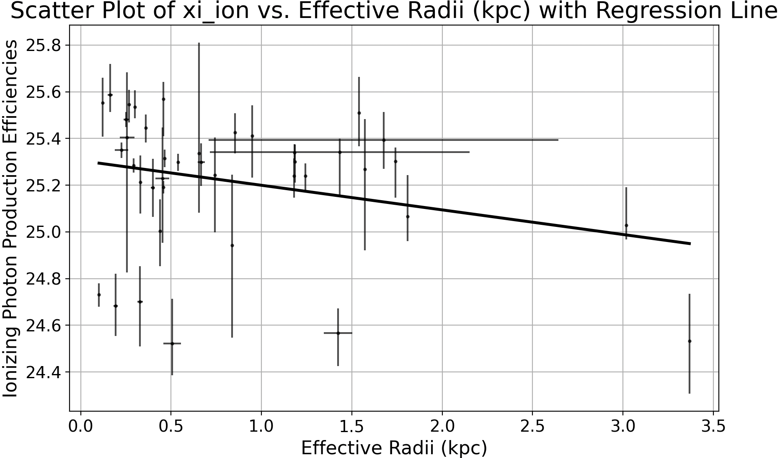
Do Smaller Galaxies Make More Ionizing Photons? + Current Implications/Future Work
Notes:
After having run these steps on all of our galaxies we took the size measurements from them and combined them with the appropriate ionizing photon production efficiencies as measured in Pahl 2024b. To my left is the result of our analysis. While our linear regression fit shows evidence of a negative trend, we performed a Spearman's correlation test on our larger dataset of galaxies to yield a p-value of 0.183, indicating a lack of significant correlation between size and ionizing photon production efficiencies. Should further analysis confirm this lack of correlation, compact galaxies could still be recognized as crucial to reionization due to their high escape fractions, though perhaps not as primary drivers. Moving forward, we plan to include more filters and extend the sample size, potentially including data from the CEERS survey, to refine our understanding.

Slide 15

Summary and Takeaway:
Compact galaxies have been demonstrated to have high escape fractions, and may be key drivers to reionization.
We measure sizes of 40 galaxies from JADES using GALFIT in order to explore the connection between ionizing photon production efficiency and galaxy effective radius.
Our current data suggests that there isn’t a statistically significant correlation between these two variables.
Future work will refine size measurements by including additional filters and will increase sample size via the CEERS survey.
Questions?
Notes:
With all that being said, what are the main takeaways for this talk?
Firstly it’s that compact galaxies have been demonstrated to have high escape fractions, which was one of the main reasons we chose to research them more in depth as having higher ionizing photon production efficiencies would’ve classified them as primary drivers of reionization.
Secondly we used Galfit to measure the sizes of these galaxies, with most of our work revolving around giving Galfit the right prerequisites for it to function properly.
Next, our results from our current research show us that although there seemed to be a relationship between size and ionizing photon production efficiency, we couldn’t definitively say statistically that there was a correlation.

Slide 16
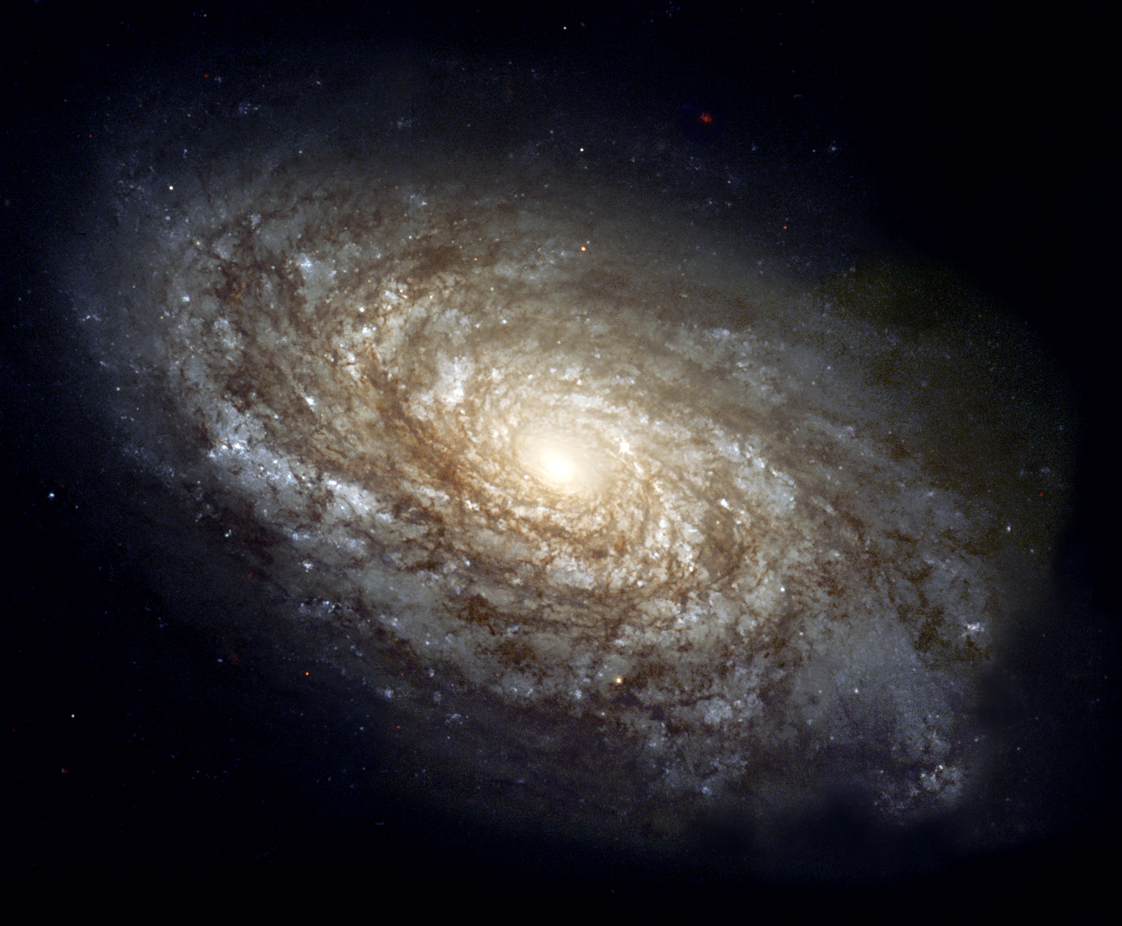
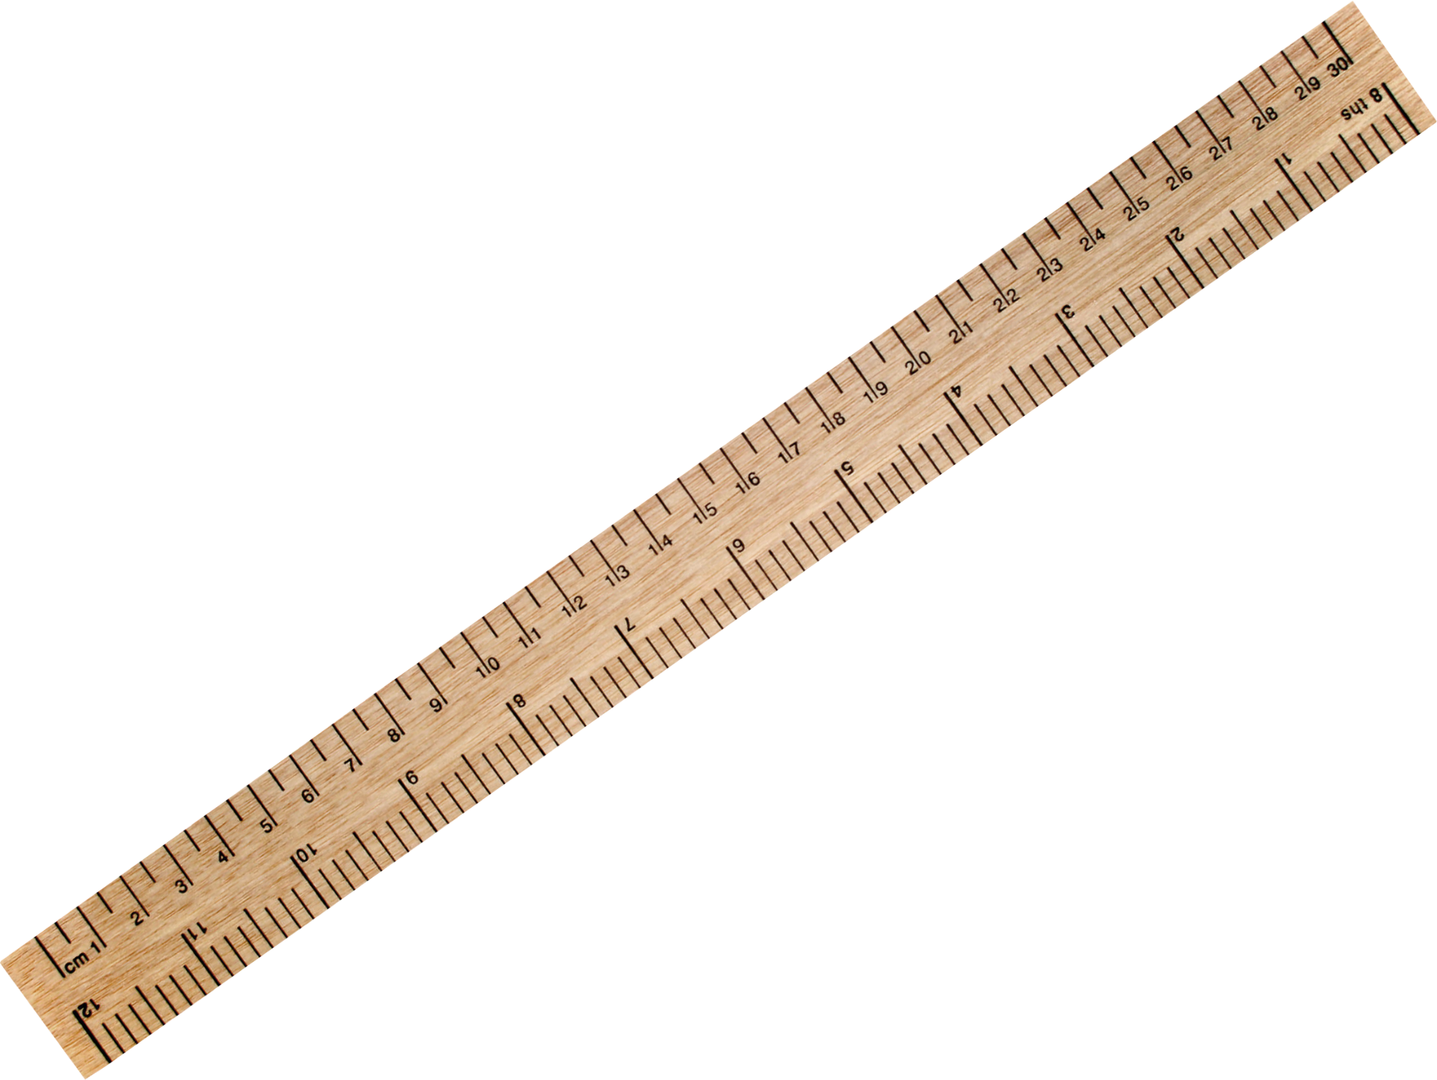
Calculating an Effective Radius in Physical Units:
Effective Radius (Pixels)
How Big Is This?
X
sqrt(Axis Ratio)
X
Arcseconds/Pixel
=
Effective Radius in Physical Units
(can convert to kpc)
(NASA 1999)
(PngImg 2024)
Notes:
After Galfit spits out data for a galaxy based off of what we’ve given it, we have to go through the process of converting the pixels that we have for the sizes of the galaxies to actual distances in physical units.
This is a little bit difficult because when we get the radius measurements from our Galfit model they’re actually measured along this thing called an elongated axis which’ll be the distance between the galaxy’s two furthest points which is usually an elliptical shape.
To correct that elliptical distance to a circle we’ll multiply what we have for the pixel value of the radius by the square root of the axis ratio which’ll be the shortest diameter of the ellipse over the longer diameter of the ellipse for a galaxy, and doing this will convert that elliptical measurement into a circular one.
Then we have to convert that pixel value into this thing known as an angular size. All of our images will have a arcseconds per pixel value which we’ll multiply our new pixel value by to get the distance of the galaxy in arcseconds.
After everything’s been said and done we’ll finally get the radius in arcseconds for that specific object, which we can further convert into kiloparsecs via a function.

